Slide 1
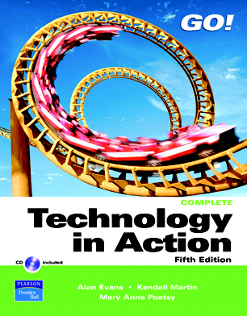

Slide 2
Technology in Action
Chapter 8
Mobile Computing:
Keeping Your Data on Hand
Notes:
This chapter discusses the advantages and disadvantages of going mobile and looks at the range of mobile computing devices you can choose from, discussing their components, features, and capabilities. Along the way, you’ll learn how you can synchronize your mobile devices to make even better use of them and become a savvy consumer, taking full advantage of mobile computing.

Slide 3
Chapter Topics
Advantages and limitations of mobile computing
Mobile computing devices:
  Pagers
  Cell phones
  PDAs
  Portable media players
Synchronizing mobile devices with computers
Tablet PCs
Notebooks
Notes:
Chapter topics include:
Advantages and limitations of mobile computing
Mobile computing devices:
Pagers
Cell phones
PDAs
Portable media players
Synchronizing mobile devices with computers
Tablet PCs
Notebook

Slide 4
Mobile Computing:
Is It Right for You?
Advantages
Convenience
Boost productivity
Communicate with others anywhere
Access to electronic information
Limitations
Expensive
Battery life
Small screen display
Slow Internet speed
Notes:
Mobile computing devices—portable electronic tools such as cell phones, PDAs, and notebooks—are changing our day-to-day lives, allowing us to communicate with others, remain productive, and access a wide array of information no matter where we are.
Still, there is a downside associated with mobile computing: Because mobile devices have been miniaturized, they’re more expensive and less rugged than stationary desktop equipment. In addition:
Battery life limits the usefulness of mobile devices.
The screen is small on most devices.
The speed of Internet connection is currently low.

Slide 5
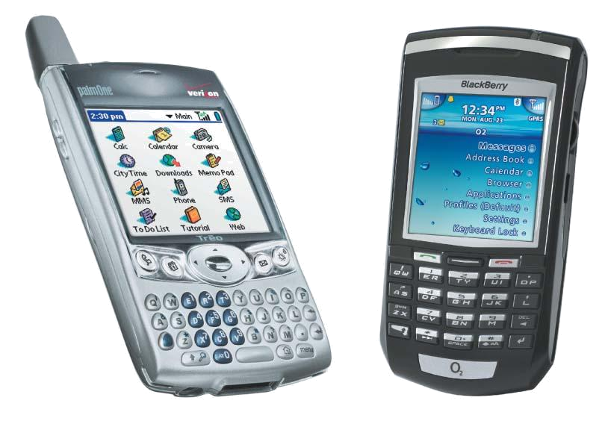
Mobile Computing Devices
Pagers
Cell phones
Portable media players
Personal digital assistants
Smartphones
Tablet PCs
Notebook computers
Notes:
There are many mobile computing devices on the market:
Paging devices provide you with limited communication capabilities but are inexpensive options if you want some of the features of mobile computing.
Cell phones feature traditional phone services such as call waiting and voice mail. Many now come with calendars, contact databases, text messaging, and e-mail capabilities.
Portable media players allow you to carry music files and other digital files.
Personal digital assistants (PDAs) are handheld devices that allow you to carry much of the same digital information as desktop systems.
Smartphones are a result of the convergence (or combination of features) of various portable devices such as PMPs, PDAs, and cellular phones. These devices attempt to provide a single solution for your portable computing needs.
Tablet PCs are larger and more powerful than PDAs and incorporate specialized handwriting-recognition software.
Notebooks are expensive and powerful tools for carrying electronic information.

Slide 6
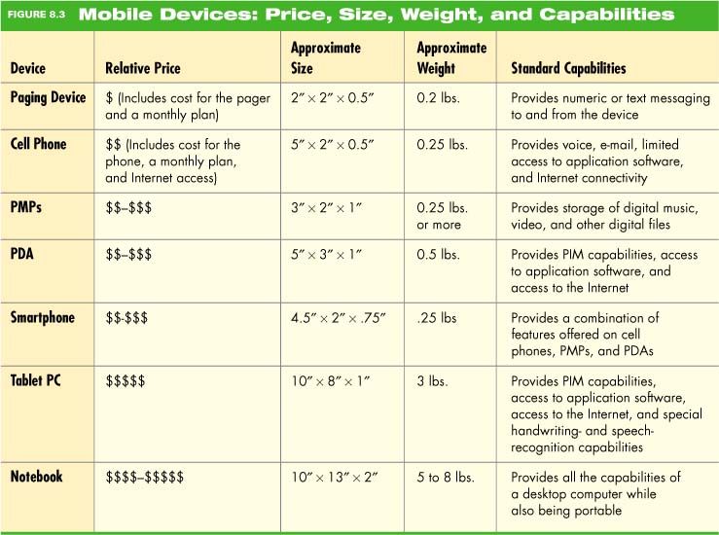
Comparing Mobile Devices
Notes:
The chart shows the relative costs, size, weight, and capabilities of mobile devices.

Slide 7
Cellular Phones
Full-featured communication and information storage devices
Features include:
  Auto-redial
  Call timers
  Voice-mail
  Voice-activated dialing
  Internet access
  Text messaging
  Personal information management
Notes:
Cell phones offer all of the features available on a traditional telephone, including auto-redial, call timers, and voice-mail. Some cell phones also feature voice-activated dialing, which is important for hands-free operation.
In addition, cell phones can offer Internet access, text messaging, personal information management (PIM) features, voice recording, and digital image and video capture.

Slide 8
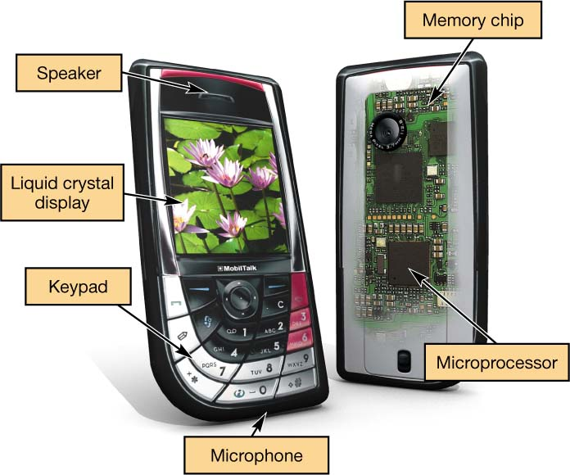
Cell Phone Hardware
Microprocessor (CPU):
  Coordinates data between components
  Runs the operating system
Memory:
  ROM stores the operating system
  Internal memory chips
Memory
Microprocessor
Notes:
Cell phones have the same components as a computer: a processor, memory, and input and output devices.
The processor coordinates sending data between the components inside the phone. It also runs the cell phone’s OS, which provides a user interface so that you can change phone settings, store information, and so on.
The OS and the information you save into your phone (such as phone numbers) are stored in memory. The OS is stored in read-only memory (ROM).
Other phone data is stored in separate internal memory chips.

Slide 9
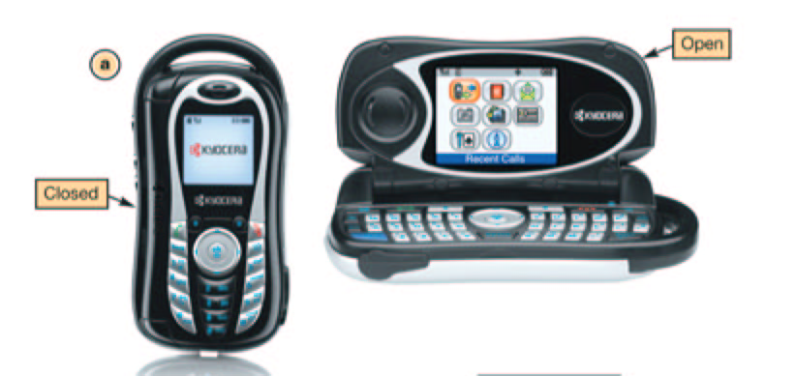
Cell Phone Hardware
Input devices:
  Microphone
  Keypad
  Graffiti pad
  Touch-screen
  Digital camera
Output devices:
  Speaker
  LCD display
Notes:
The input devices for a cell phone are primarily the microphone and a keypad. Some phones feature the Palm Graffiti pad as well as touch-sensitive screens that allow you to input data. In addition, more and more cell phones include digital cameras.
Cell phone output devices include a speaker and an LCD display. Higher-end models include full-color, high-resolution plasma displays. Some cell phones include two displays: an outside LCD display you can see when the phone is folded and a separate display inside.

Slide 10
How Cell Phones Work
Analog-to-digital converter chip converts voice sound waves into digital signals
Digital signal processor compresses the signal so it can be sent to another phone
Digital data is transmitted as radio waves
Digital signal processor decompresses incoming calls
Notes:
When you speak into a cell phone, the sound enters the microphone as a sound wave. Because analog sound waves need to be digitized (that is, converted into a sequence of 1s and 0s that the cell phone’s processor can understand), an analog-to-digital converter chip converts your voice’s sound waves into digital signals.
Next, the digital data must be compressed, or squeezed, into the smallest possible space so that it will transmit more quickly to another phone. The processor cannot perform the mathematical operations required at this stage quickly enough, so a specialized chip, called the digital signal processor, is included in a cell phone to handle the compression work.
Finally, the digital data is transmitted as a radio wave through the cellular network to the destination phone.
When you receive an incoming call, the digital signal processor decompresses the incoming message. An amplifier boosts the signal to make it loud enough, and it is then passed on to the speaker, from which you hear the sound.

Slide 11
Cell Phone Features
Popular Text Messaging Abbreviations
Text messaging:
  Short Message Service (SMS):
    Sends messages up to 160 characters
    Free SMS information
  Multimedia Message Service (MMS):
    Sends text, sound, images, and video clips
AFAIK As far as I know
IDK I don’t know
B4N Bye for now
JAS Just a sec
BRB Be right back
LOL Laughing out loud
CUL See you later
QPSA ¿Qué pasa?
FBM Fine by me
T+ Think positive
F2T Free to talk
TTYL Talk to you later
G2G Got to go
WUWH Wish you were here
HRU How are you?
YBS You’ll be sorry
Notes:
Short Message Service (SMS) (text messaging) is a technology that allows you to send short text messages (up to 160 characters) over mobile networks. To send SMS messages from your cell phone, you simply use the numeric keypad or a presaved template and type in your message.
An extension of SMS called Multimedia Message Service (MMS) allows you to send messages that include text, sound, images, and video clips to other phones or e-mail addresses.

Slide 12
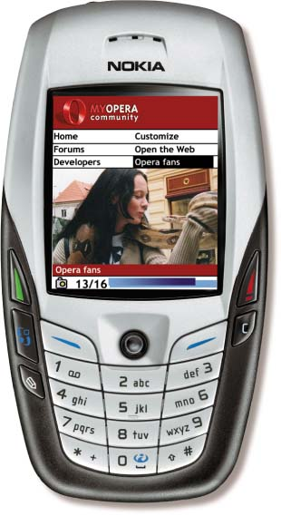
Cell Phone Internet Connectivity
Wireless Internet service provider
Internet connectivity plans: usually known as data plans
Speeds of 200–300 Kbps
Micro-browser software
Difficult to display Web pages on small screen
Notes:
Just as you pay an Internet service provider (ISP) for Internet access for your desktop or notebook computer, connecting your cell phone to the Internet requires that you have a wireless Internet service provider (or wireless ISP). Phone companies that provide cell phone calling plans (such as T-Mobile, Verizon, and Cingular) usually double as wireless ISPs. Internet connectivity plans, and often text messaging plans, are usually known as data plans.
Cell phone connect at a speed that won’t exceed 200 to 300 Kbps.
EDGE (short for Enhanced Data Rate for Global Evolution) and EVDO (Evolution Data Optimized) standards have brought mobile devices much faster data transfer, up to 700 Kbps (or more) under ideal conditions.
It is difficult to display Web pages on cell phones without a great deal of horizontal scrolling to view content.
Microbrowser software is optimized to display Web content effectively on a smaller screen.

Slide 13
Cell Phone Internet Connectivity
Checking e-mail is a popular feature
Special “push” technology delivers e-mail to a cell phone
Viruses can target cell phones
Antivirus software for mobile devices is available
Notes:
A popular feature of cell phones with Internet access is checking e-mail.
E-mail devices feature special “push” technology to automatically deliver your e-mail to your phone .
Viruses can target cell phone.
Symantec, McAfee, and F-Secure are the leading companies currently providing antivirus software for mobile devices.

Slide 14
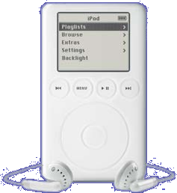
Portable Media Players
MP3
  Format for storing music
Portable media player (PMP)
  A small device that stores and plays music
Number of songs stored
  Storage available
  Sampling rate
Notes:
Portable media players (PMPs) are small portable devices (such as an iPod) that enable playing of MP3 files anywhere.
MP3 is a format for efficiently storing music as digital files, or a series of bits.
Digital files (using special data formats such as AVI or MPEG-4) can hold video, audio, or images.
Many companies are now manufacturing PMPs that handle video and still images as well as music files.
The number of songs a PMP can hold depends on how much storage space it has.
Inexpensive PMPs use built-in flash memory, a type of nonvolatile memory, to store files. Some of the PMPs that use flash memory allow you to add storage capacity by purchasing removable flash memory cards.
Other PMPs use a hard disk drive and can store a much larger amount of music.
Another factor that determines how much music a player can hold is the quality of the MP3 music files. The sampling rate is the number of times per second the music is measured and converted to a digital value. Sampling rates are measured in kilobits per second (Kbps). The higher the sampling rate, the better quality the sound, but the larger the file size.

Slide 15
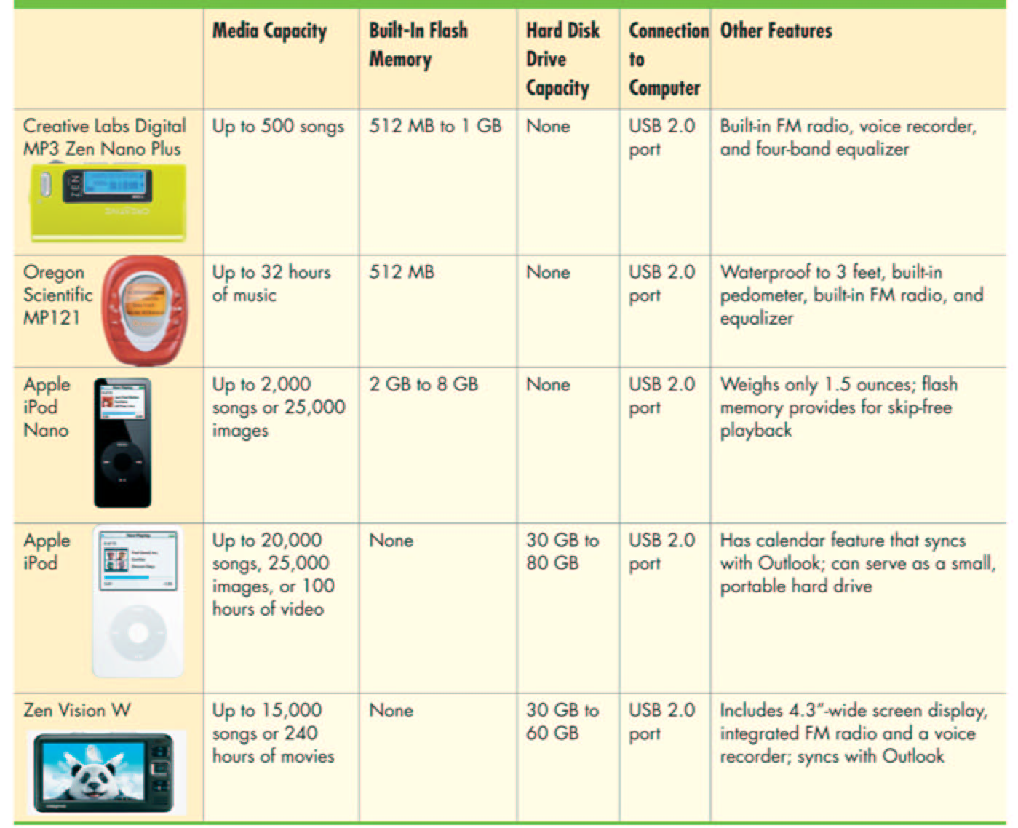
Popular PMPs
Notes:
This chart compares several PMPs.

Slide 16
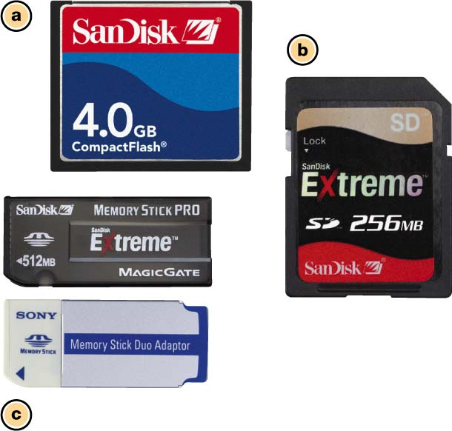
PMP Flash Memory
Used to add additional memory to portable media players
Flash memory: nonvolatile memory
  64 MB to 8 GB
Built-in hard drives
  Up to 80 GB
Software enables transfer of audio and video files
Notes:
Some PMPs allow you to add additional, removable flash memory cards. Flash memory cards are noiseless, very light, use very little power, and slide into a special slot in the player.
Because flash memory is nonvolatile, when you store data on a flash memory card, you won’t lose it when you turn off the player. In addition, flash memory can be erased and rewritten with new data.
Several different types of flash cards are used with different models of MP3 players.
One popular type is Compact Flash cards. These are about the size of a matchbook and can hold between 64 MB and 4 GB of data.
Multimedia cards and SmartMedia cards are about the same size as CompactFlash cards but are thinner and less rugged.
Sony devices use a special format of flash memory called the Memory Stick.
Particular models of MP3 players can support only certain types of flash cards, so check your manual to be sure you buy compatible memory cards.
Portable media players come with software that enables transfer of audio and video files from your computer onto the player.

Slide 17
PMP Ethical Issues
Is it illegal to download MP3 files?
  MP3.com:
    Song files are on a public server
    Permission is given by the artist or recording company to place the files on the server
    A fee is paid to download a file.
  Napster:
    A file exchange site
    Song files were borrowed from users’ computers (peer-to-peer [P2P] sharing)
    Sued for copyright infringement
Notes:
The fundamental right of an artist to own his or her own material has come under significant pressure due to the ease of downloading and sharing MP3 files. However, it is a double-edged sword, for musicians need an audience first and a paying audience second. Those with a paying audience want to keep it that way and those with no audience want to find one. So a musician trying to get noticed sees the Internet and MP3 as a way to distribute music with little cost, and if the music is good enough, develop a following who might pay in the future. The very same technology works against a musician who is able to sell music, for now it can gotten easily for free. Existing schemes try to work both ways, with thousands of samples available so a person can listen before the purchase. On the other hand, any musician can distribute music for free.
Music is also being distributed between people directly on the Internet. Using “peer-to-peer” services, people share their files directly.

Slide 18
Podcasting
Distributing non-music MP3 files over the Internet
Podcasts can be information, books on tape, audio plays, etc.
People can listen when they wish
iPod synchronization transfers new content.
Notes:
Podcasting allows users to download audio content and to then listen to those broadcasts on their PMPs whenever they want.
Podcasting is paving the way to enable anyone to create a radio show at home and to easily distribute it to an audience.
Plugging your iPod into a data port on your computer causes synchronization. The iPod searches iTunes for new content and automatically transfers it.

Slide 19
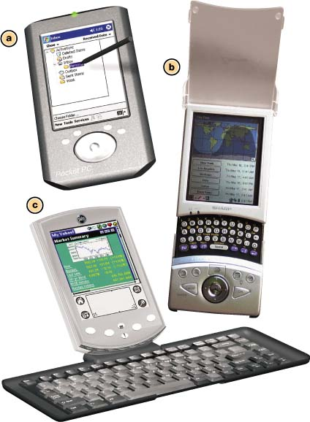
Personal Digital Assistants
Small devices that store digital information
Known as palm computers or handhelds
PDA hardware includes:
  CPU
  Operating system
  Storage capabilities
  Input/output devices
  Ports
Notes:
A personal digital assistant (PDA) is a small device that allows you to carry digital information.
Often called palm computers or handhelds, PDAs are about the size of your hand and usually weigh less than 5 ounces.
Although small, PDAs are quite powerful and can carry all sorts of information, from calendars to contact lists to specially designed personal productivity software programs (such as Excel and Word), to songs, photos, and games.
And you can easily “synchronize” your PDA and your home computer so that the changes you make to your schedules and files on your PDA are made on your home or office computer files as well.

Slide 20
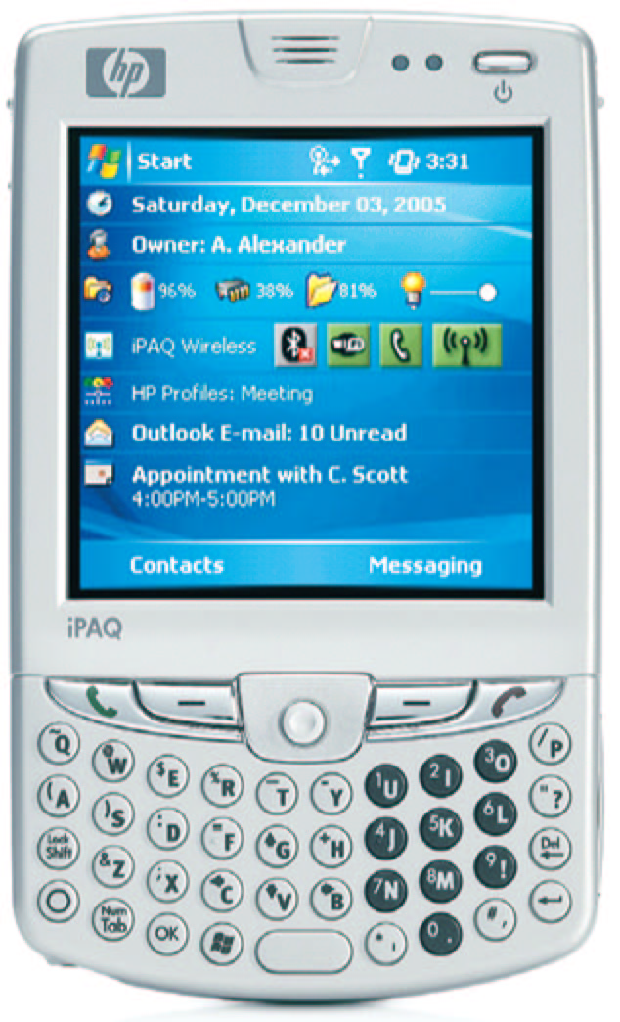
PDA Input and Output Devices
Input devices
  Touch-screen with stylus
  Keyboards
    Graffiti text system
Output devices
  LCD displays
Notes:
All PDAs feature touch-sensitive screens that allow you to enter data directly with a penlike device called a stylus. To make selections, you simply tap or write on the screen with the stylus.
Other PDAs include integrated keyboards or support small, portable, folding keyboards.
With a touch screen and stylus, you can use either handwritten text or special notation systems to enter data into your PDA. One of the more popular notation systems is the Graffiti text system. Another popular system is Microsoft Transcriber.
PDAs come with LCD screens in a variety of resolutions. High-end color displays are almost 4 inches and can have resolutions as high as 480 x 640.

Slide 21
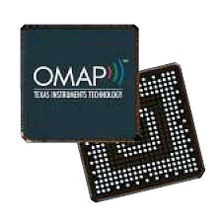
PDA Processors
Popular processors
  Samsung SC
  Texas Instruments OMAP
  Intel XScale
Comparing processors
  Speed
  Performance
    Benchmarking
  Power consumption
Notes:
Popular PDA processors (CPUs) on the market today include the Motorola DragonBall, the Texas Instruments OMAP, and the Intel XScale processor.
When comparing PDA processors, one consideration to keep in mind is processor speed, which is measured in hertz and is the number of operations (or cycles) the processor completes each second.
Processor speed is not the only aspect of the processor that affects performance. To measure performance, PDA reviewers often run the same task on competing PDAs and then compare the time it takes to complete the task. This process is called benchmarking and gives a good indication of the unit’s overall system performance.
When comparing PDAs, also look for the expected operating time on one battery charge.

Slide 22
PDA Operating Systems
Two main OS competitors
  Palm OS
  Windows Mobile
Windows Mobile by far most popular
Features include:
  Calendar
  To-do list
  Contact information
  Viewing videos
  Playing MP3 files
Extra application software is available
Notes:
The two main OS competitors on the PDA market today are the Palm OS and the Windows Mobile system from Microsoft.
Palm OS is found on PDAs made by Palm. Windows Mobile is by far the most popular and is used by Compaq, HP, Dell, and Toshiba—and now even by Palm—on their PDA models and some smartphones
The Palm OS clearly ruled with market share just a few years ago. This was due primarily to the Palm OS’s ability to work more efficiently on slower processors and PDAs with less memory.
However, Windows Mobile is now crushing Palm in terms of market share. Today’s PDAs sport fast processors with up to 128 MB of RAM, which allow Windows Mobile to deliver speedy performance. In addition, Microsoft was quicker to embrace support for new technologies such as hardware graphics acceleration and EVDO high-speed networking. Both operating systems can now handle Word, Excel, and PowerPoint files, but Windows Mobile was the first to synchronize easily with Outlook, thereby providing a significant advantage for users who use Outlook as their main e-mail software. Consequently, Windows Mobile is outselling the Palm OS now by a vast margin.

Slide 23
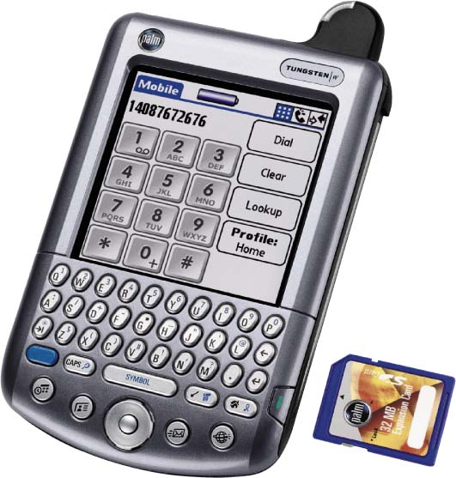
PDA Memory and Storage
ROM stores the operating system and the basic programs
RAM stores additional applications and data
Flash memory is used for additional storage
Notes:
PDAs do not contain internal hard drives.
In PDAs, ROM is used to hold the OS as well as the most basic programs the PDA runs, such as the calendar, to-do list, and contact list.
RAM holds additional applications and any data you load into the PDA. However, because RAM is volatile storage, and you do not want your data to disappear when you shut off your PDA, a small amount of power is taken from the battery to keep the data “alive” even while the PDA is off.
For memory needs beyond built-in RAM and ROM, PDAs use flash memory.

Slide 24
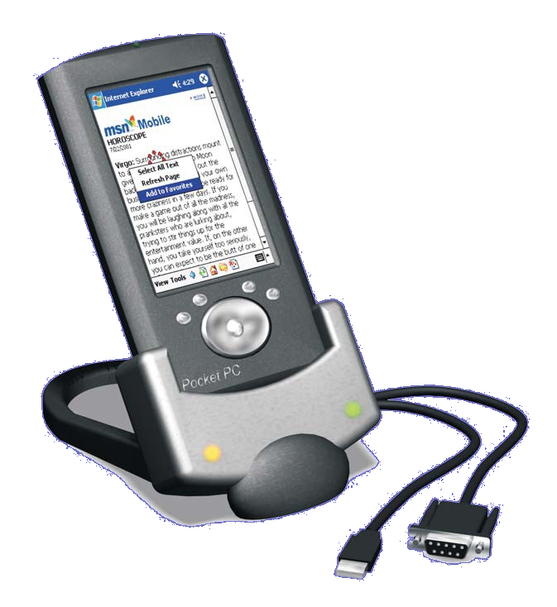
PDA File Transfer and Synchronization
PDA files can be transferred to a desktop using:
  Flash card readers
  Cradles
Synchronizing updates files on both the PDA and desktop
  Sync cables
  Windows Vista Sync Center
Wireless transfers
  IrDA
  Bluetooth
Notes:
If you’re transferring data from your PDA to another computer and it accepts the type of flash card you’re using, you can simply pull the flash card out of your PDA and slip it into the flash card reader on your computer.
You can also transfer your data from your PDA to a desktop by using a device called a cradle. You can also use the PDA cradle to synchronize your PDA with your computer.
The process of updating your data so the files on your PDA and computer are the same is called synchronizing. To synchronize your desktop and PDA, you place the PDA in its cradle and touch a “hot sync” button.
Microsoft has recognized the vast increase in portable computing devices by integrating synchronization into Windows Vista. This feature is known as Sync Center
Many PDAs include an IrDA port that transmits data signals using infrared light waves. Another type of wireless connection available for PDAs is Bluetooth, which uses radio waves to transmit data signals over short distances (up to about 30 feet).

Slide 25
PDA Internet Connectivity
An Internet connection requires a wireless ISP
Web pages are accessed using Wireless Application Protocol (WAP)
Notes:
As is the case with cell phones, connecting your PDA to the Internet requires that you have a wireless ISP, which costs an additional monthly fee. Once you’re on the Internet, you can use your PDA to send and receive e-mail and use all the features you’re familiar with from your desktop computer, including attachments, blind and carbon copies, and distribution lists.
Wireless Application Protocol (WAP) is the standard that dictates how handheld devices will access information on the Internet. WAP supports all the major PDA OSs.

Slide 26
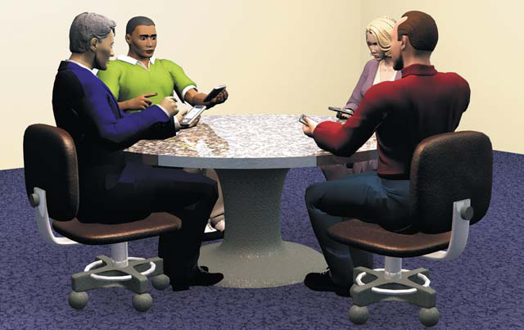
PDA Software and Accessories
Standard software
  To-do list
  Contacts manager
  Calendar
Additional software
  Microsoft Word, Excel, Outlook and PowerPoint
  Games
  Tools
  References
Notes:
Most PDAs come with a standard collection of software such as a to-do list, contacts manager, and calendar.
Software applications such as Word and Excel are also available for PDAs. Although these programs are not as full featured as their desktop counterparts, they can read and create files that can be transmitted to full-version applications on your home computer.
In addition, a variety of games, tools, and reference applications are available for PDAs.

Slide 27
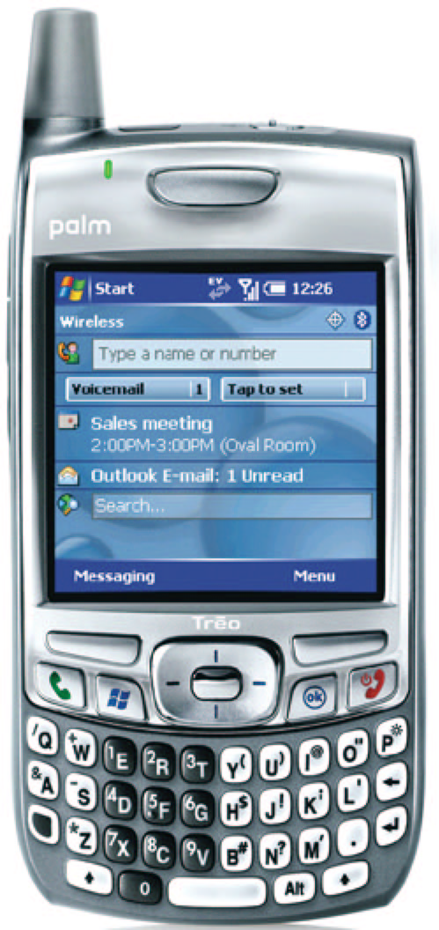
PDA or Cell Phone
Cell phones with PDA capability
PDAs with cell phone capability
Smartphones
Notes:
A number of devices are being released that attempt to combine a cell phone, an MP3 player, and a PDA into one unit.
These kinds of mobile devices are called “smartphones” and represent a step toward the ideal of “convergence,” being able to have a single compact device that features all of these capabilities.
However, each is making some compromises: there are features available on the best cell phones and PDAs that are missing from the smartphones currently on the market.

Slide 28
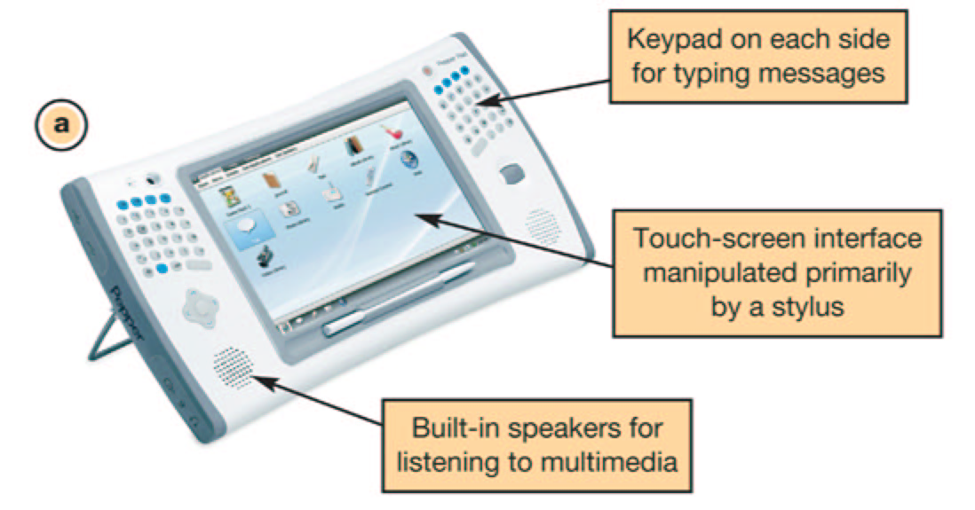
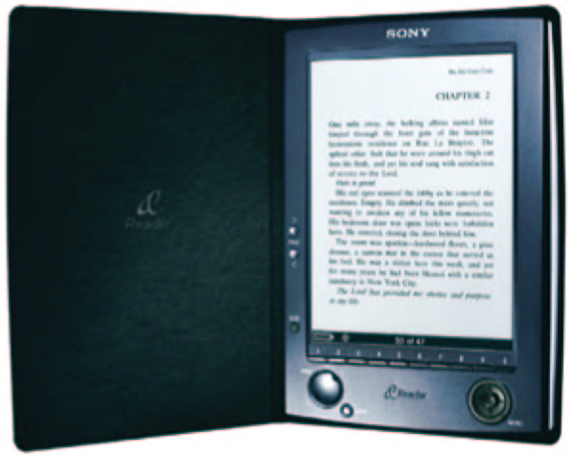
Other Devices to Consider
Pepper Pad 3
  Designed for surfing the Web
  Can serve as a remote for home entertainment system
Sony Portable Reader System
  Holds 160 e-books
Notes:
Specialized computing devices designed for mobility are hitting the market more regularly.
The Pepper Pad 3 is a portable device with a large 7-inch screen that provides a significant advantage over PDA or cell phone screens. It is designed primarily for surfing the Web, e-mailing, instant messaging, and downloading or streaming multimedia from the Web. It can even function as a remote control for your home entertainment system.
For avid readers of e-books, the Sony Portable Reader System could be just what you are looking for. Featuring 128 MB of internal memory, it can hold 160 e-books. And if that isn’t enough, it accepts flash memory cards for even more storage.

Slide 29
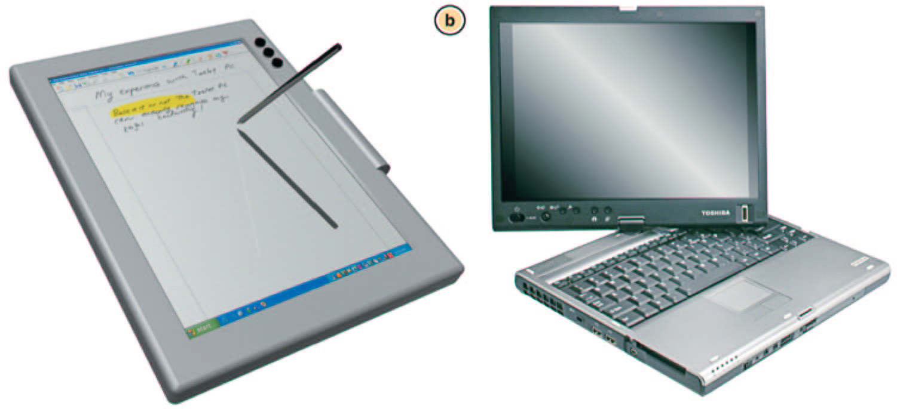
Tablet PCs
Portable computers with handwriting recognition and speech recognition
Two monitor modes
  Notebook
  Tablet
Notes:
A tablet PC is a portable computer that is lightweight, features advanced handwriting recognition, and can be rotated into a clipboard style.
Tablet PCs are available from a variety of manufacturers, come in a variety of designs, and are about the same size as a clipboard.
Tablet PCs are named such because the monitor can be used either in a traditional notebook mode or in “tablet mode,” much like an electronic clipboard. Tablet PCs also can be connected to a full-size keyboard and monitor.

Slide 30
Tablet PC Hardware
Tablet PC hardware includes:
  CPU
  Storage capabilities
  Input/output devices
  Ports
Digital ink technology:
  Pressure-sensitive screen
  Digital pen
Notes:
Like any computer, a tablet PC includes a processor, OS, storage capabilities, input and output devices, and ports. What makes the tablet PC unique, however, is the way in which you input data into it.
The most innovative input technology on the tablet is its use of digital ink. Supporting digital ink, the tablet PC’s entire screen is pressure-sensitive and reacts to a digital pen. Once you enter text with the pen using your own handwriting, it is automatically converted to type-written text.

Slide 31
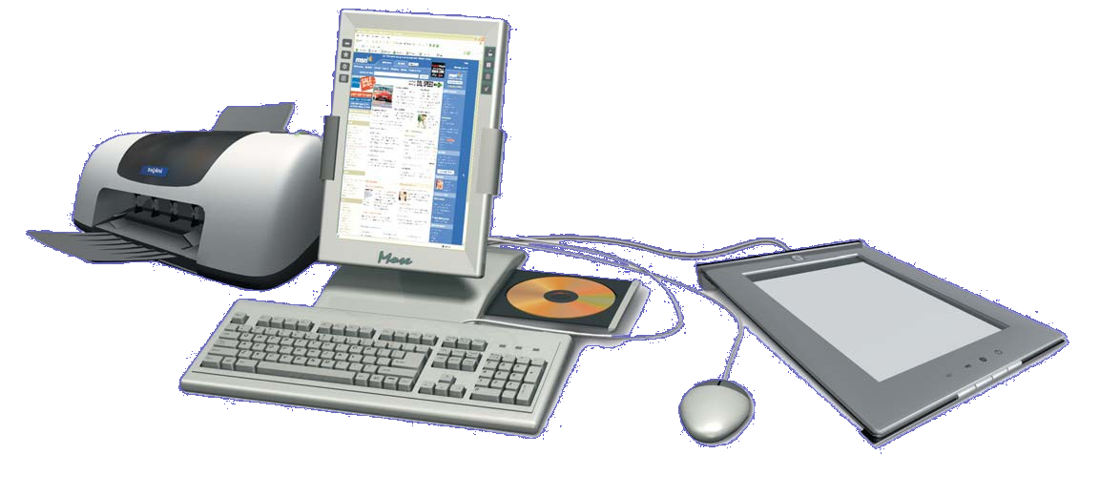
Tablet Software
Windows Vista is the operating system
  Digital ink
  Handwriting recognition
Applications programs compatible with Windows Vista are available
Notes:
Tablet PCs used to run the Windows XP Tablet PC Edition operating system. But since Windows Vista was designed with native support for digital ink and handwriting recognition, Vista is now the operating system you’ll find on new tablet PCs.
Tablets can run any applications designed for Windows Vista. Windows Vista includes the Tablet PC Input Panel, which is an accessory available on Tablet PCs that enables you to use handwriting or an on-screen keyboard to enter text (take notes).

Slide 32
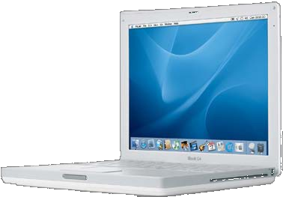
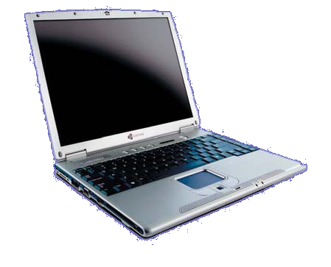
Notebooks
Also called laptops
Computing power of a desktop
Weigh more than tablets
Notes:
The most powerful mobile computing solution is a notebook computer.
Notebooks offer large displays and all of the computing power of a full desktop system.
Most notebooks weigh more than tablets.

Slide 33
Notebook Hardware
DVD/CD-RW drives
Hard drives
RAM
Hot-swappable bays:
  Remove a drive and replace it with another type
Keyboard
Built-in mouse
LCD displays
Notes:
Notebooks can be equipped with DVD/CD-RW drives, large hard drives, and 4 GB or more of RAM.
Although the size of a notebook might prohibit it from having all of the drives you’re interested in, newer models feature hot-swappable bays. This means that when the notebook is running, you can remove a DVD drive and exchange it with a removable hard drive, for example, allowing the notebook to be much more versatile.
Input devices on notebooks include keyboards with built-in mouse functionality.
In terms of output devices, many notebooks include large display screens measuring up to 17 inches diagonally.

Slide 34
CPUs for Notebooks
Slightly slower than desktop CPUs
Dual-core CPUs
  Difference in speed is less noticeable
Windows Vista
  Allows for RAM to be used more efficiently
Notes:
CPUs available for notebooks are usually a bit slower than the latest available CPU offered for desktop units. Whereas existing desktops can currently run a 3.4-GHz processor, most notebook CPUs run at speeds less than 2.4 GHz
Many notebooks now use dual-core CPUs, which makes the difference in processing speed much less noticeable.
In addition, the new memory management schemes of Windows Vista allow the computer to use RAM more efficiently, which has also helped eliminate any noticeable performance differences between notebooks and desktops.

Slide 35
Notebook Operating Systems
Same operating systems as those found on desktops
Power management
  Shuts down the hard drive
  Turns off the monitor
  Puts the computer into standby mode
Notes:
Notebooks use the same operating systems that run on desktop systems.
Notebook operating systems have some special settings, such as power management profiles. A power management profile contains recommended power-saving settings, such as turning off your hard drive after 15 minutes of no use, shutting down the monitor after 20 minutes of no movement, and switching the machine to standby or hibernation mode after a certain length of time.

Slide 36
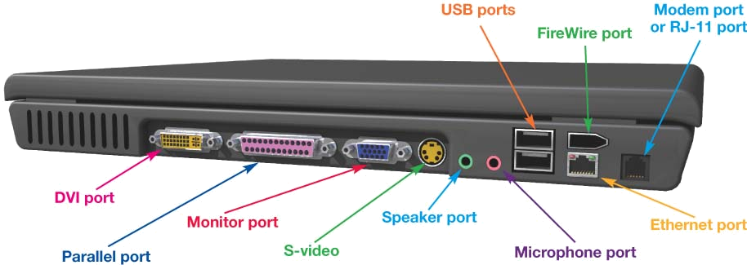
Notebook Ports
A full set of ports:
  Parallel
  Monitor
  USB
  Modem
  Ethernet
  Audio
  FireWire
  PCI type I/II card slots
  DVI
  IrDA
Notes:
Notebooks include a full set of ports, including FireWire, USB 1.0 and 2.0, serial, parallel, IrDA, RJ-11 jacks for a modem connection, and Ethernet ports for wired networking connections.
Video ports often include high-quality S-video connectors as well as digital DVI connectors, which allow a pure digital signal to run to a digital flat panel monitor.
Most notebooks also have integrated support for wireless connectivity, including WiFi and Bluetooth.

Slide 37
Windows Mobility Center
Gives details on
  Display brightness
  Battery status
  Power management plant
  Wireless network connections
  External displays
  Presentation systems (projectors) connected
Notes:
Windows Vista has a feature called the Windows Mobility Center that is designed to help keep track of functions on mobile computers. When the Windows Mobility Center is open, you can see at a glance details on display brightness (which affects battery life), battery status, power management plant, wireless network connections, external displays, and presentation systems (projectors) connected.

Slide 38
Wireless Network Connections for Notebooks
Most notebooks have integrated support for wireless connectivity
802.11g WiFi wireless standard is most common
802.11n is gaining in popularity
Bluetooth chips
Notes:
Most notebooks have integrated support for wireless connectivity.
The 802.11g WiFi wireless standard is the most common standard used in wireless networks today, but 802.11n is gaining in popularity.
The 802.11g standard allows wireless connections to operate at up to 54 Mbps and 802.11n will provide even faster transfer rates and extended range.
Many notebooks also offer built-in Bluetooth chips that allow you to connect to other Bluetooth-enabled devices.

Slide 39
Notebook Batteries and Accessories
Batteries lighter than previous generations
No “memory effect”
A battery rated at 5 A-hrs can provide 5 amps of current for an hour
AC/DC or DC/DC converter
Ultraportable (or subnotebook)
Notes:
Rechargeable batteries today come in two main types. The new batteries are lighter than previous generation batteries and do not show the “memory effect” that old batteries did. Memory effect means that the battery must be completely used up before it is recharged.
The capacity of a battery is measured in ampere-hours (A-hrs). Ampere is a measure of current flow, so a battery rated at 5 A-hrs can provide 5 amps of current for an hour. Battery power depends on the device you’re using and the work you’re doing
Some environments support easy access to power for notebooks. For example, you can use an AC/DC or DC/DC converter to enable a notebook to run in a car without using battery power.
The ultraportable (or subnotebook) category of computers consist of notebooks that weigh 4 pounds or less.

Slide 40
Notebook or Desktop?
Desktop
  Better value in terms of computing power for your money
  More expansion possibilities
  More reliable
  Lasts longer
Notebook
  Portable
Notes:
Desktop systems are invariably a better value than notebooks in terms of computing power gained for your dollar. Because of the notebook’s small footprint (the amount of space on the desk it takes up), you pay more for each component. Each piece has had extra engineering time invested to make sure it fits in the smallest space. In addition, a desktop system offers more expandability options. It’s easier to add new ports and devices because of the amount of room available in the desktop computer’s design.
Desktop systems also are more reliable. Because of the amount of vibration that a notebook experiences, as well as the added exposure to dust, water, and temperature fluctuations, notebooks do not last as long as desktop computers. Manufacturers offer extended warranty plans that cover accidental damage and unexpected drops, though at a price.

Slide 41
Chapter 8 Summary Questions
What are the advantages and limitations of mobile computing?
Notes:
What are the advantages and limitations of mobile computing?

Slide 42
Chapter 8 Summary Questions
What are the various mobile computing devices?
Notes:
What are the various mobile computing devices?

Slide 43
Chapter 8 Summary Questions
What can pagers do, and who uses them?
Notes:
What can pagers do, and who uses them?

Slide 44
Chapter 8 Summary Questions
How do cell phone components resemble a traditional computer, and how do they work?
Notes:
How do cell phone components resemble a traditional computer, and how do they work?

Slide 45
Chapter 8 Summary Questions
What can I carry in a portable media player, and how does it store data?
Notes:
What can I carry in an portable media player, and how does it store data?

Slide 46
Chapter 8 Summary Questions
What can I use a PDA for, and what internal components and features does it have?
Notes:
What can I use a PDA for, and what internal components and features does it have?

Slide 47
Chapter 8 Summary Questions
How can I synchronize my PDA with my desktop computer?
Notes:
How can I synchronize my PDA with my desktop computer?

Slide 48
Chapter 8 Summary Questions
What is a tablet PC, and why would I want to use one?
Notes:
What is a tablet PC, and why would I want to use one?

Slide 49
Chapter 8 Summary Questions
How powerful are notebooks, and how do they compare to desktop computers?
Notes:
How powerful are notebooks, and how do they compare to desktop computers?

